Slide 1


Global Climate Change
Week 4 - Anthropogenic Impacts on Climate
Dr Simon O’Meara
Thomas.Bannan@Manchester.ac.uk
Notes:
Welcome
Individual introductions

Slide 2

Mid-Semester Surveys are Open!
Tell us how your semester is going so far.
Your feedback helps improve your programme and student experience.
The survey has just 4 quick questions and takes only a couple of minutes.
Your feedback is confidential, responses will be reviewed at programme level

Slide 3

Global Climate Change
Week 1 – Introduction to climate change and its impacts (5th Feb)
Week 2 – Natural climate variability (12th Feb)
Week 3 – Radiation and the Greenhouse Effect (19th Feb)
Week 4 – Anthropogenic Impacts (25th Feb)
Week 5 – The Evidence Base for Climate Change (5th March )
Week 6 – Mid Unit Test (10th March)
Week 7 – Climate Models (19th March
Week 8 – Climate change adaptation (26th March)
Week 9 – Effects of Climate Change: Case Studies (23rd April)
Week 10 – Climate change mitigation (30th April)
Week 11 – Revision Lecture (7th May)
Comments/Questions

Slide 4

Today’s class
  Part 1: Lecture and 1st workshop (80 mins)
  Part 2: Q/A (10 mins)
  Part 3: 2nd workshop (20 mins)

Slide 5
Last Week: Greenhouse Effect
Solar radiation
high temp’ source
Short Waves
SPACE
Some of the infrared
radiation is absorbed
and re-emitted by the
greenhouse gases.
SUN
Some solar radiation is
reflected by the earth’s
surface, clouds and the atmosphere
This warms the surface and the atmosphere
Some solar radiation is absorbed by clouds and other gases
ATMOSPHERE
Terrestrial radiation
low temperature source
Long Waves
Most solar radiation
Passes straight through the atmosphere
and is absorbed to
warm the surface
EARTH

Slide 6

Intended Learning Outcomes
By the end of this lecture, you will be able to:
Describe the main components of the Earth’s energy budget and assess how internal and external forcings can influence them, including the timescales associated with these changes.
List anthropogenic impacts on climate beside carbon dioxide and methane
Describe the relative impact of anthropogenic changes on climate
Describe the mechanisms by which “other” (beside carbon dioxide and methane) anthropogenic changes affect Earth’s energy budget

Slide 7
Intended Learning Outcomes
Anthropogenic impact on climate | When Covered | Additional Reading (Canvas Linked)
Carbon dioxide and methane | Previous lecture
Aerosols | This lecture | Ramanathan et al. (2001)
Ozone | This lecture | Introduction of Skeie et al. (2020)
Land-Use Change | This lecture | Introduction of Ghimire et al. (2014)

Slide 8
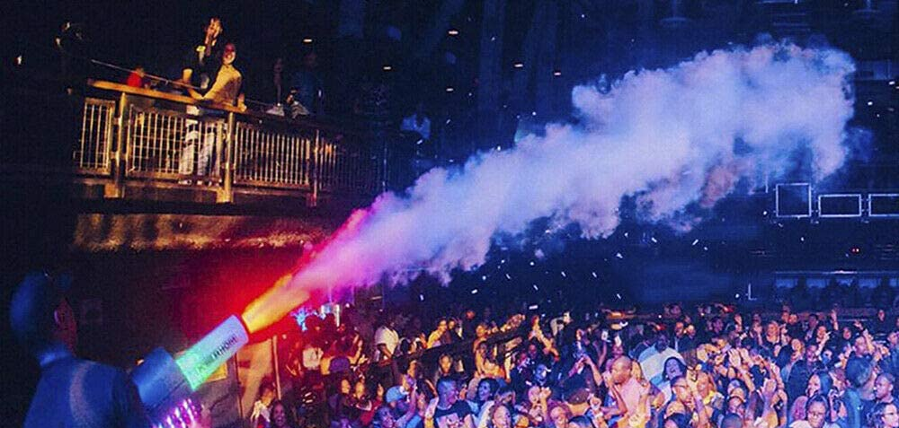
Need to know:
Aerosol is suspended particles in gas
Definition from page 47 Atmospheric chemistry and physics: from air pollution to climate change
Seinfeld, John H.; Pandis, Spyros N., 1963-2016]; Third edition.

Slide 9

Aerosol introduction
Aerosol is a mixture of gas and suspended particles
An airborne chemical will partition between the gas- and particle-phase
For example, black carbon has a very low volatility so is always in the particle-phase, whereas water is more volatile so is always present in the gas-phase, and often also in the particle-phase

Slide 10
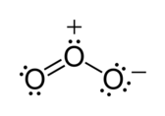
Ozone introduction
Ozone (O₃) is present in both the stratosphere and troposphere
Human release of ozone-depleting-substances has acted to decrease ozone concentrations in the stratosphere at poles in winter
Human release of ozone precursors has acted to increase ozone concentrations in the troposphere

Slide 11
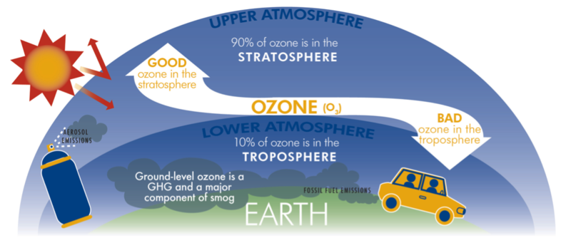
Ozone introduction

Slide 12
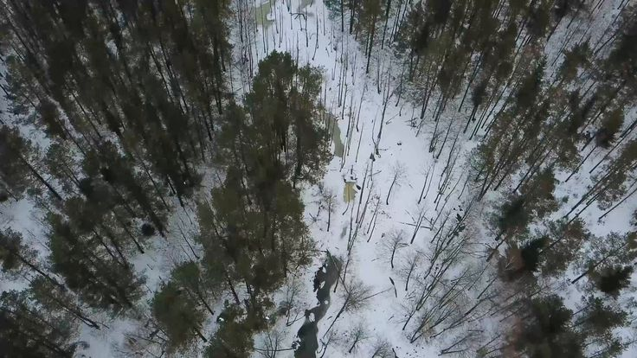
Land-Use Change introduction
Human perturbation of land cover
Note, emissions of carbon dioxide and methane due to agriculture are included under the radiative forcing of these gases rather than under land-use change (as reported by IPCC)
Affects radiative forcing and also vertical distribution of energy

Slide 13
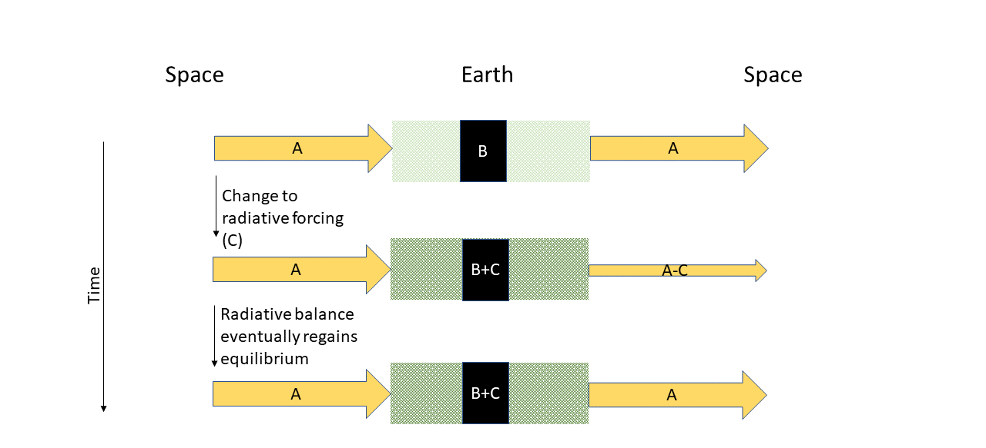
Radiative forcing
What is radiative forcing?
  An effect on Earth’s radiation balance, more specifically:
  The change in radiation balance at the tropopause between the incoming solar radiation and the outgoing earth’s radiation (net irradiance)
Notes:
In this case, if ‘C’ affects the atmosphere, then a greenhouse gas is at play and the greenhouse effect results.

Slide 14
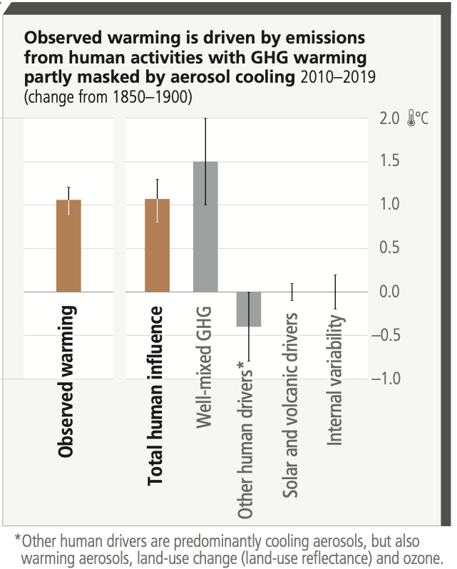
Radiative forcing
Natural changes to radiative forcing can be relatively extreme (in magnitude and rate), e.g. volcanic eruption
Natural can include changes to: greenhouse gas sinks and albedo
But, for the industrial period, anthropogenic changes to radiative forcers have been much greater than natural changes
Although the sources vary between natural and anthropogenic drivers, the resulting physics (radiative forcing) is the same
Today we look at ‘Other human drivers’
Figure 2.1 d) Climate Change 2023 Synthesis Report
Notes:
Link to synthesis report: https://www.ipcc.ch/report/ar6/syr/downloads/report/IPCC_AR6_SYR_LongerReport.pdf

Slide 15
Radiative forcing
-What is it?
-What is the associated radiative forcing?
-How does the radiative forcing come about (mechanism)?
-Aerosol
-Ozone
-Land-Use Change
Figure 2.1 d) Climate Change 2023 Synthesis Report

Slide 16
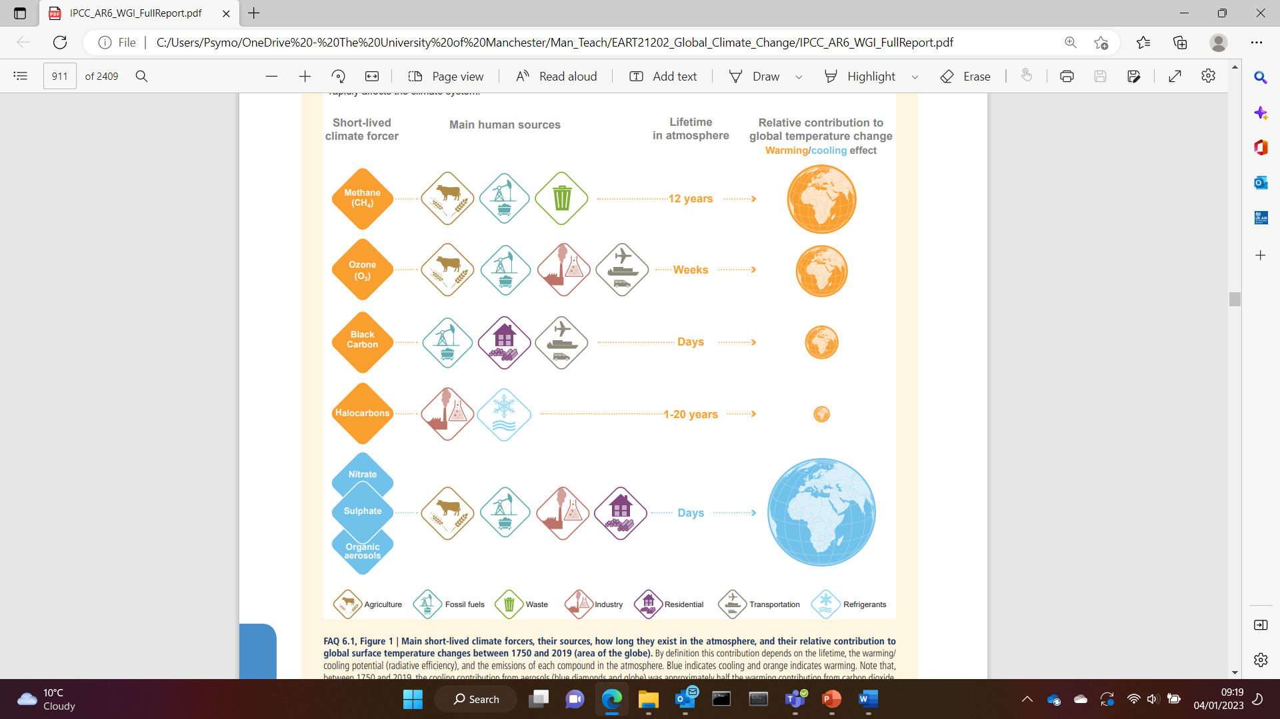
Aerosol summary
The colour of aerosol determines whether it absorbs or reflects incoming solar radiation
Aerosols stay airborne on the timescale of minutes to weeks, with an average of days. Key loss processes are dry deposition and wet deposition.
FAQ 6.1, Figure 1, AR6 WGI

Slide 17
Aerosols: aerosol-radiation interaction
Direct effect
☀️
brown carbon
_{Emission of particles,}
and gases that can become particle
black carbon
salts like ammonium sulphate
page 844 AR6 WG1
Notes:
Aerosols influence the climate system through multiple pathways.
Firstly, aerosols can directly affect the Earth’s energy balance by interacting with solar radiation. This process is known as aerosol-radiation interaction or the direct effect.
Non-absorbing aerosols, like sulfate, nitrate and most of the organic aerosols, can scatter sunlight back into space. This increases the Earth's albedo (reflectivity) and has a cooling effect on the climate.
Some aerosols can absorb solar radiation, warm the surrounding air and contributes to a warming climate effect. The best-known type of absorbing aerosol is black carbon. Certain types of organic aerosols are also absorbing, which is called brown carbon.
The overall direct effects of aerosols depend on their size, composition and optical properties. Their location in the atmosphere also plays a crucial role. For example, if an elevated absorbing aerosol layer is above low-lying clouds, it will have a stronger warming effect compared to being over a clear sky. This is because the absorbing aerosol layers can also absorb the solar radiation reflected by the underlying clouds.

Slide 18


Aerosols: aerosol-cloud interaction
Indirect effect: Cloud microphysics --> cloud albedo effect
Indirect effect: The cloud lifetime effect
Cloud Condensation nuclei (CCN)
_{Emission of particles,}
and gases that can become particle
_{Emission of particles,}
and gases that can become particle
Notes:
Aerosols also influence climate by interaction with clouds. Clouds cover roughly two-thirds of the Earth’s surface. They can modify Earth’s top of the atmosphere (TOA) radiation budget by reflecting incoming solar radiation, thereby enhancing the earth’s albedo
Aerosols can affect climate system by modifying cloud microphysics and lifetime, which is called “indirect effect”. They can act as Cloud Condensation Nuclei (CCN), providing surfaces for water vapor to condense and form cloud droplets. The aerosol ability to become a CCN is dependent on its hygroscopic nature, which is affected by aerosol size and composition. Larger aerosol particles are generally more efficient CCN. Inorganic aerosols like sulfate and nitrate are generally more hygroscopic than carbonaceous aerosols.
More aerosols or CCN typically lead to more cloud droplets with smaller droplet size. In this way, clouds become more reflective and enhance their cooling effect. The smaller size of cloud droplets also increases their time remaining in the cloud, suppressing the precipitation. This can extend cloud lifetime, further enhancing their cooling effect.
The rapid adjustments to atmospheric thermodynamics due to aerosols, is commonly referred as “semi-direct effect”. This can also affect cloud amounts. For example, when absorbing aerosols, such as black carbon, immersed in or surround cloud droplets, they can absorb lights, heat the surrounding air and evaporate clouds, thus reducing cloud cooling effect.
Above is a brief introduction of how aerosols influence the climate system through interaction with radiation and clouds. the next question is how we can assess their climate effects.

Slide 19
Aerosol-radiation vs. aerosol-cloud
Effective radiative forcing (ERF, W m⁻²):
Quantifies the change in the Earth's energy balance caused by a climate driver
Instantaneous change in the energy budget
Rapid adjustments: Rapid changes in the atmosphere (such as changes in cloud and water vapor) that are uncoupled to any global surface air temperature change.
Anthropogenic ERF over the industrial era (1750–2014)
Effect | Effective radiative forcing (W m⁻²) | Uncertainty (Wm⁻²) (confidence level) | Reference
Aerosol-radiation interaction | -0.3 | ±0.3 (medium confidence) | Figure 7.5 and supporting text on page 955 of AR6 WG1
Aerosol-cloud interaction | -1.0 | ±0.7 (medium confidence)
Total | -1.3 | -2.0 - -0.6 (medium confidence)
Notes:
A key metric used to assess the climate effects of a forcer is Effective Radiative Forcing (ERF), which quantifies the change in the net energy flux at the top of the atmosphere (TOA) due to a climate forcer. It accounts for the instantaneous change in radiation, for example, the direct scattering and absorption of incoming solar radiation by aerosols. It also accounts for the subsequent rapid adjustments. Here, rapid adjustments represent immediate changes in the atmosphere and surface in response to a climate forcer, normally taking place over short timescales from days to months. These adjustments involve processes such as changes in clouds and water vapor. For example, when the increased aerosols lead to more cloud droplets with smaller sizes, this delays precipitation, leading to an increase in cloud fraction, Such adjustments could enhance the cooling effect. Additionally, the semi-direct effects we talked earlier, the absorbing aerosols change the thermodynamics, heat the air, and dry the clouds, Such adjustments could reduce the cooling effect. By considering both instantaneous radiative effects and rapid adjustments, ERF provides a more comprehensive assessment of how aerosols and other climate forcers alter the Earth’s energy balance. Positive ERF values indicate a warming effect and negative ERF values indicate a cooling effect.
In the recent IPCC report, the assessment of aerosol ERF employs observation- and model-based estimates. Observational estimates include satellite -based measurements. Model estimates include simulations using global climate models and Earth System models. The ERF relative to the Year 1750 is regarded as anthropogenic influence over the industrial era. From the IPCC report, the global average ERF for aerosol-radiation interaction and aerosol-cloud interaction for 2014 relative to 1750 are assessed to be –0.3 W m–2 and –1.0 W m–2, respectively. The total aerosol ERF is assessed to be –1.3 W m–2. There is strong evidence for a substantial global cooling effect of anthropogenic aerosols.

Slide 20
Aerosol-Radiation vs. Aerosol-Cloud
Anthropogenic ERF over the industrial era (1750–2014)
Effect | Effective radiative forcing (W m⁻²) | Uncertainty (Wm⁻²) (confidence level) | Reference
Aerosol-radiation interaction | -0.3 | ±0.3 (medium confidence) | Figure 7.5 and supporting text on page 955 of AR6 WG1
Aerosol-cloud interaction | -1.0 | ±0.7 (medium confidence)
Total | -1.3 | -2.0 - -0.6 (medium confidence)
Uncertainties are from properties of aerosol: composition, abundance, number-size distribution, hygroscopicity, which in turn affects aerosol-radiation and aerosol-cloud effects
Notes:
We can notice that there are significant uncertainties in estimating aerosol climate effects, particularly those related to aerosol-cloud interactions.
Where are the uncertainties from?
We have introduced that aerosol are short-lived species and unevenly distributed. It is challenging to capture spatial and temporal variations in aerosol concentrations accurately.
We have also introduced that aerosol interaction with clouds and radiation are dependent on aerosol physicochemical properties. However, characterizing these properties across different environments remains uncertain.
There are also limitations with existing observational and modelling techniques.
Improving our understanding of aerosol climate effects requires continued observational and modelling research in the future.

Slide 21
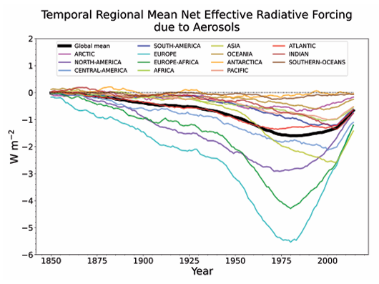
Aerosol: radiative forcing
Future?
Aerosol reduction offers trade-off for climate and air pollution
page 853 AR6 WG1
Notes:
From the assessment of aerosol ERF, we can understand that anthropogenic aerosols have exerted a substantial global cooling effect since the industrial era.
Here is the temporal evolution of global and regional aerosol ERF.
We can see, Until the late 20th century, ERF values indicate an increasing cooling effect of anthropogenic aerosols. This trend aligns with rapid industrialization and growing aerosol emissions from human activities.
However, as emission regulations and air quality policies have been implemented in many regions, the aerosol cooling effect reached a peak and started to decline.
I want to leave you with a take-away question:
The most recent IPCC report we just presented provides valid aerosol ERF until 2014. What do you think the trend of aerosol ERF will be in the future? Will it be continuously decreasing cooling effect or else?
Ok, here is all my talk related to the climate forcer, aerosol. We have explored how human activities affect aerosol emission, how aerosols interact with climate system, and how to assess aerosol climate effect.

Slide 22
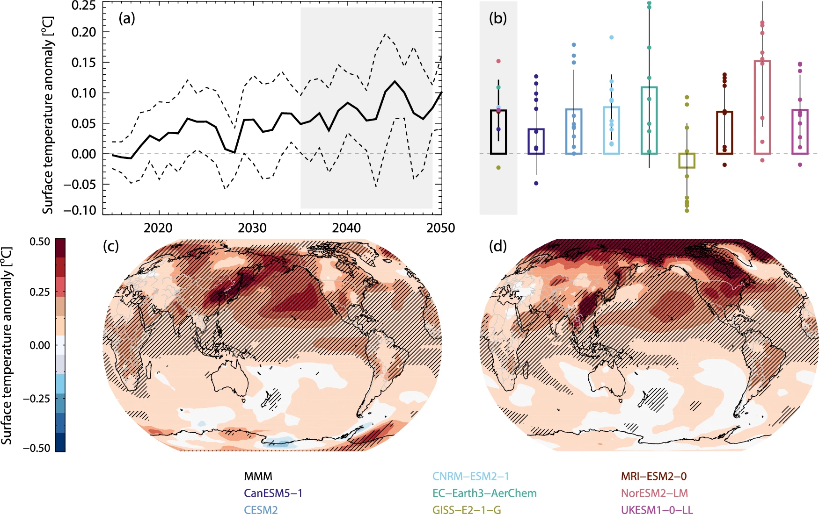
Aerosol: radiative forcing
Baseline simulations are
compared against perturbation simulations to quantify effect of changes such as East Asian aerosol emission reduction
Fig. 2 Samset et al. 2025
doi.org/10.1038/s43247-025-02527-3

Slide 23
How much from aerosol?
Most of it – as will be shown, total anthropogenic aerosol effect has a magnitude around 2x greater than ozone effect (ozone effect is positive) and 4x greater than land-use change
Figure 2.1 d) Climate Change 2023 Synthesis Report

Slide 24
1st Workshop
Your research group has funding to forecast the effect of reducing ammonium sulphate loading in the global troposphere on radiative forcing.
You are planning the methodology, which is based on a baseline vs. perturbation setup, what science needs to be included for an accurate forecast?
-Consider how long into the future you will need to simulate to quantify effect
-Consider the mechanisms that will need to be simulated
-Consider where uncertainties will come from

Slide 25
Ozone detail
10 % of atmospheric ozone is in the troposphere, whilst 90 % is in the stratosphere
Anthropogenic perturbation of tropospheric ozone dominates the anthropogenic influence on ozone radiative forcing – page 947 of AR6 WG1 reports that the positive radiative forcing in the troposphere is around 20x that of the radiative forcing in the stratosphere
NO tends to convert to NO₂ in the presence of CO, CH₄, VOCs
Therefore, the precursors for O₃ are: NO_{x}, CO, CH₄, VOCs
hv
NO₂ -> NO + O(³P)
O(³P) + O₂ -> O₃
Notes:
Vast majority of ozone production by humans is secondary, i.e. humans release chemicals that are not ozone, but those chemicals can produce ozone once in the atmosphere

Slide 26
Ozone has an average atmospheric lifetime of 3 weeks, so it is not well mixed throughout the atmosphere
Ozone detail
Warming results from the increased atmospheric concentrations of ozone precursors (NOx, CO, CH4, VOCs) due to anthropogenic emission
Anthropogenic influence on atmospheric ozone has caused warming

Slide 27
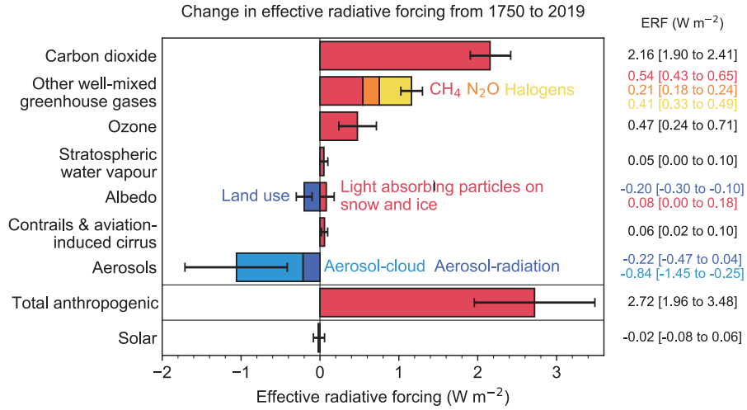
Ozone: radiative forcing
Ozone is able to absorb both incoming ultraviolet radiation AND outgoing infrared radiation. Both absorption bands mean that increased tropospheric ozone has a positive effective radiative forcing (warming).
Third most important greenhouse gas behind methane and carbon dioxide
Shorter lived than methane and carbon dioxide (average lifetime in atmosphere of 3 weeks)
The magnitude of its ERF is around half that of aerosol and around double that of land-use change
Figure 2.1 d) Climate Change 2023 Synthesis Report
Fig 7.6 AR6 WG1

Slide 28
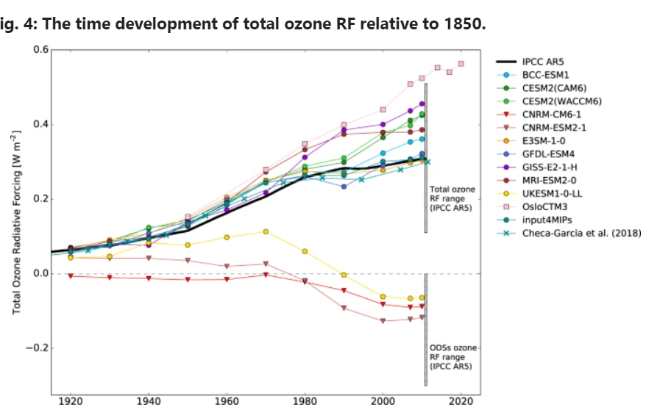
Ozone: total vs only stratosphere effect
Complicated picture, but all
models agree that effect from tropospheric gain in ozone dominates over changes to stratospheric ozone
RF from total ozone change
RF from stratospheric ozone change
Ozone offers co-benefits for climate and air pollution
Fig 4. of Skeie et al. 2020

Slide 29
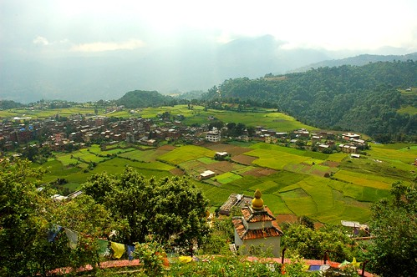

Land-Use Change detail
Section 7.3.4.1 of AR6 WG1 Report
Affects radiative forcing, mostly through albedo change
Affects vertical distribution of energy in atmosphere (this not an effect on radiative forcing)
What is lifetime of land-use change?
Nepal: https://www.flickr.com/photos/wonderlane/2462899238/
Lake District (UK): https://wallpapercave.com/lake-district-wallpapers
Notes:
The perturbation of natural land cover by humans is global. By surface area (and therefore most influential on radiative forcing with regards to albedo and cloud cover), the most important conversion is natural land to agriculture, with minor effects from conversion to other human uses like cities
For change to radiative forcing we must consider the original and new cover type. In particular, the height of the vegetation structure, i.e. trees or no trees
For change to vertical distribution of energy we must consider the change to canopy evaporation, ground evaporation and transpiration

Slide 30
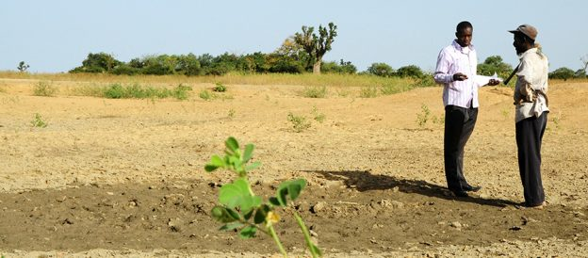
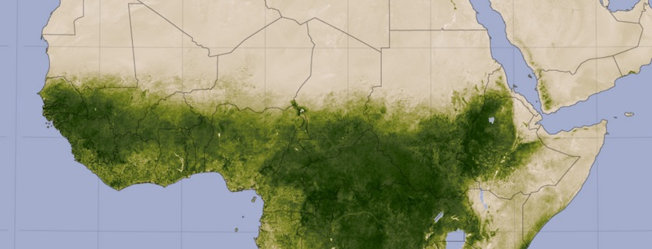
Radiative forcing for land-use change
Changing tree and shrub cover to farmland in semi-arid regions reveals soil that is brighter than leaves
-> increases albedo
Changing tree cover to farmland at higher latitudes reveals more snow-covered ground -> increases albedo
https://www.wunderground.com/cat6/Its-January-Time-Earths-Closest-Approach-Sun-True
https://farmingfirst.org/2019/01/what-is-the-resilience-deficit-and-how-is-it-being-tackled-in-the-sahel/

Slide 31
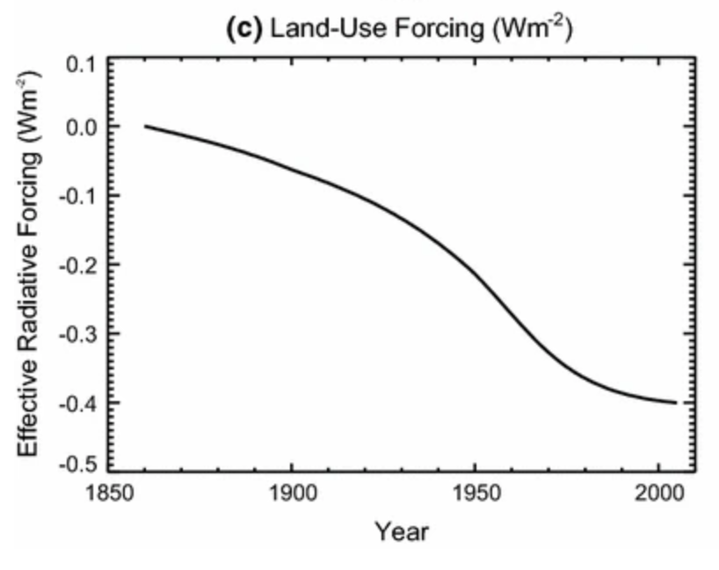
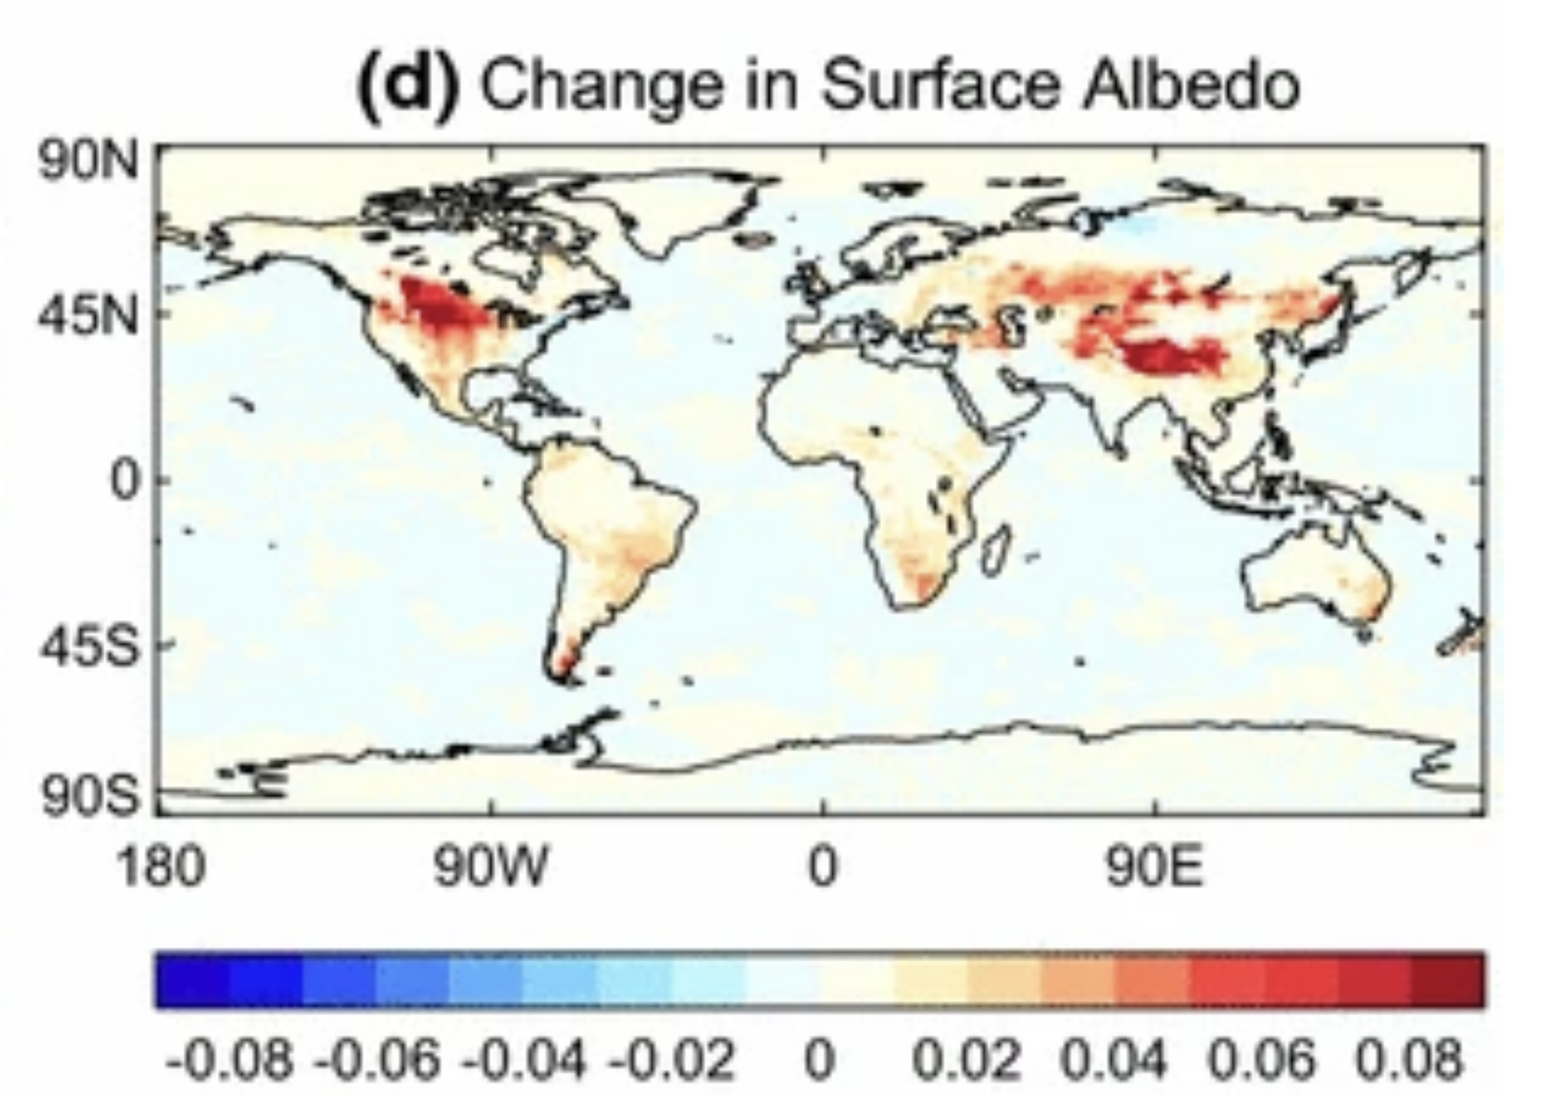
Radiative forcing for land-use change
Fig. 1c and 3d of Andrews et al. 2017 (https://doi.org/10.1007/s00382-016-3280-7)

Slide 32
Albedos
Surface Type | Albedo
Ocean | 0.07
Coniferous forest | 0.16
Earth average | 0.31
Sand | 0.35
Fresh snow | 0.9

Slide 33
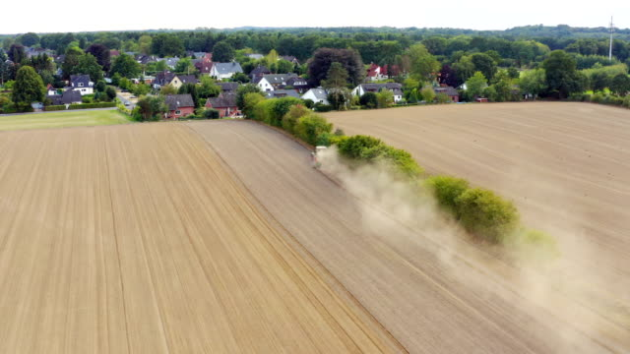
Affects vertical distribution of energy – not a radiative forcing
Land-Use Change
Solar energy incident on surface is converted to sensible and latent heat
Can affect local and regional climate significantly
More liquid water available means lower sensible heat:latent heat
Less liquid water available means higher sensible heat:latent heat
Notes:
https://www.gettyimages.de/video/dried-tree

Slide 34
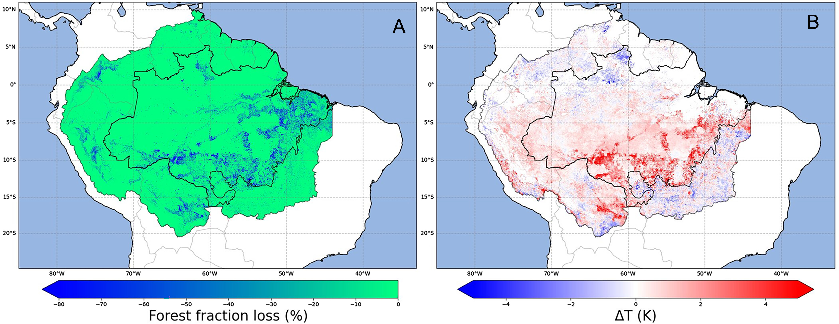
Affects vertical distribution of energy – not a radiative forcing
Land-Use Change
Deforested tropical areas warm at surface because cooling via evapotranspiration decreases, e.g. Amazon in fig. below
This is a local effect
But local feedbacks have the potential to amplify global feedbacks, e.g. decreased forest resilience in Amazon
Fig. 1 of Butt et al. 2023
Notes:
Local surface warming in Amazon for co-located deforestation: https://doi.org/10.1073/pnas.2309123120
Local temperature changes due to land-use change: doi.org/10.1126/science.1118160
Amazon resilience: doi.org/10.1038/s41558-022-01287-8

Slide 35
Land-Use Change: rapid adjustment
Land-use change effect on clouds is mixed – sometimes increasing cloud cover (e.g. increased irrigation), sometimes decreasing (e.g. rainforest removal), therefore overall rapid adjustment is around zero
Effective radiative forcing from land-use change is around half the magnitude of ozone and around quarter the magnitude of aerosol
Fig 7.6 AR6 WG1

Slide 36
Comparison of anthropogenic effects and uncertainties
Figure 2.1 d) Climate Change 2023 Synthesis Report
Fig 7.6 AR6 WG1

Slide 37
2nd Workshop
Define radiative forcing and describe how ozone and land-use change have affected it since 1750. In your answer consider the mechanisms by which these drivers influence radiative forcing, their lifetimes, spatial extent, and compare their radiative forcing magnitude against other important drivers.

Slide 38
Lecture Summary
Human activities alter Earth’s climate by changing the balance between incoming solar radiation and outgoing infrared radiation through aerosols, ozone, and land-use change.
  Aerosols (days–weeks lifetime) mostly cool the climate via increased albedo (direct reflection and cloud effects), making them the largest non-CO₂ anthropogenic forcing.
  Tropospheric ozone (weeks lifetime) acts as a short-lived greenhouse gas, warming the climate by absorbing both UV and infrared radiation.
  Land-use change modifies surface albedo, generally producing a net cooling with strong regional variation.
Overall, these “other” anthropogenic forcings are shorter-lived than CO₂ but exert significant and, to varying extents, uncertain, influences on Earth’s energy budget and climate.

Slide 39
Next Week: The Evidence Base for Climate Change
In next week’s lecture:
Outline the main observational records used to reconstruct temperature and carbon dioxide, and the timescales over which they apply
Explain the key lines of evidence linking human activity to rising global temperatures
Discuss the main sources of uncertainty in climate science, and why some aspects of climate change are better understood than others

Slide 40
Global Climate Change
Week 4 – Questions and Answers

